Slide 1
Creating a maven project

Slide 2
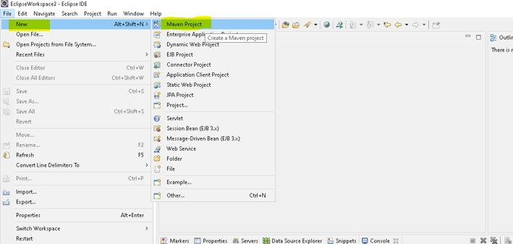

Slide 3
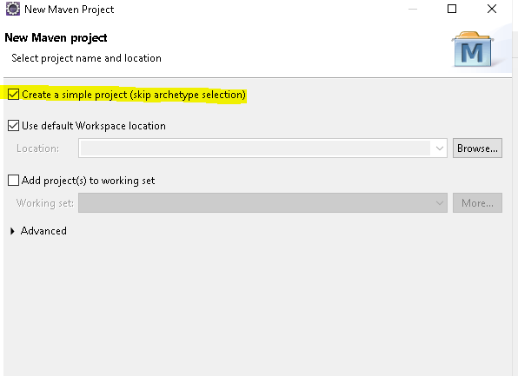

Slide 4
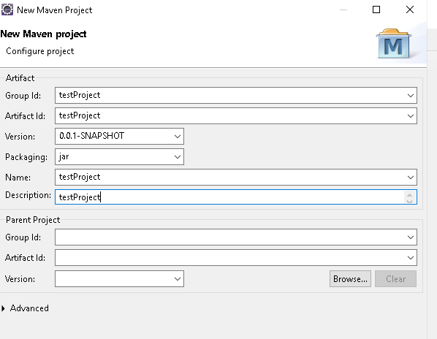

Slide 5
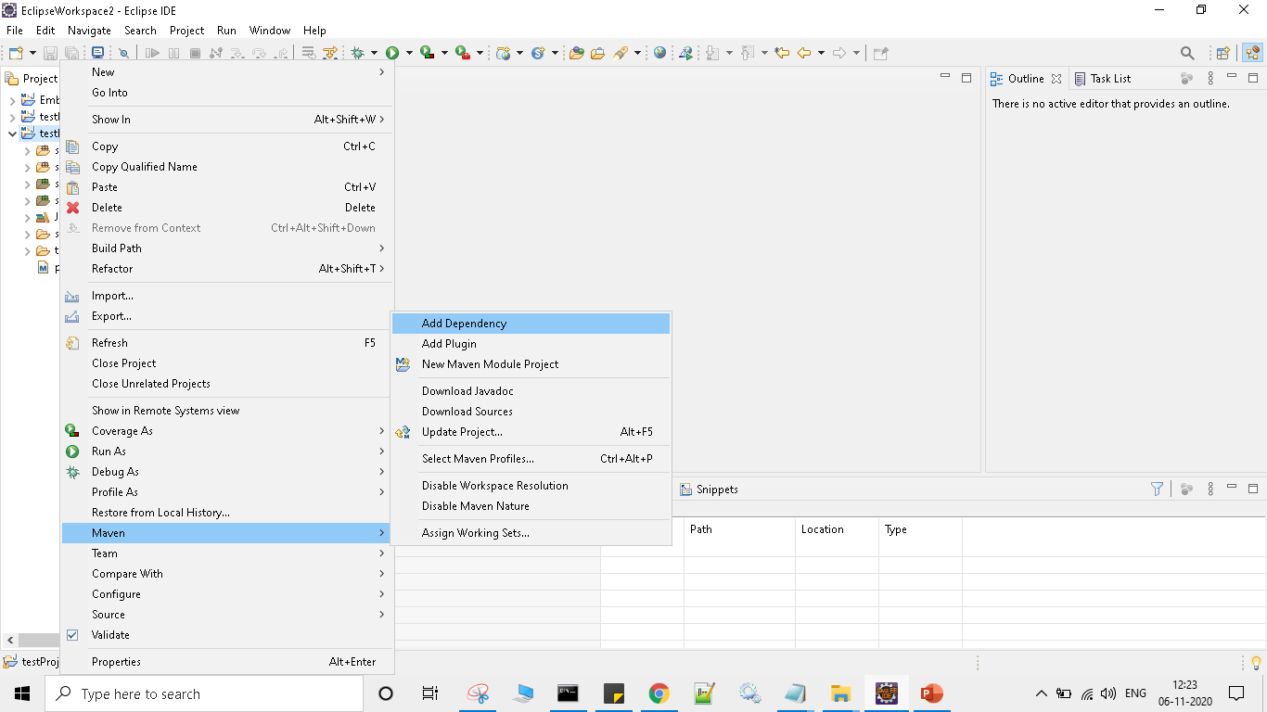

Slide 6
dependency>
<groupId>org.apache.poi</groupId>
<artifactId>poi</artifactId>
<version>3.12</version>
</dependency>
<dependency>
<groupId>org.apache.poi</groupId>
<artifactId>poi-ooxml</artifactId>
<version>3.12</version>
</dependency>

Slide 7
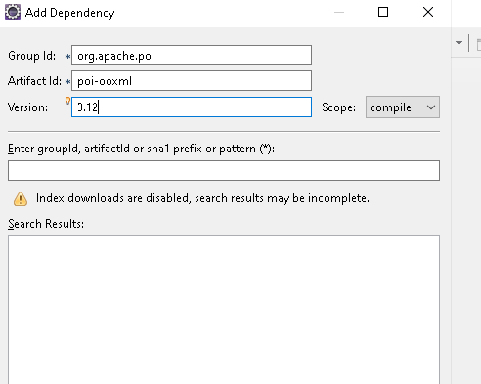
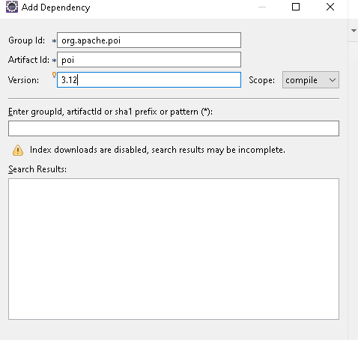

Slide 8
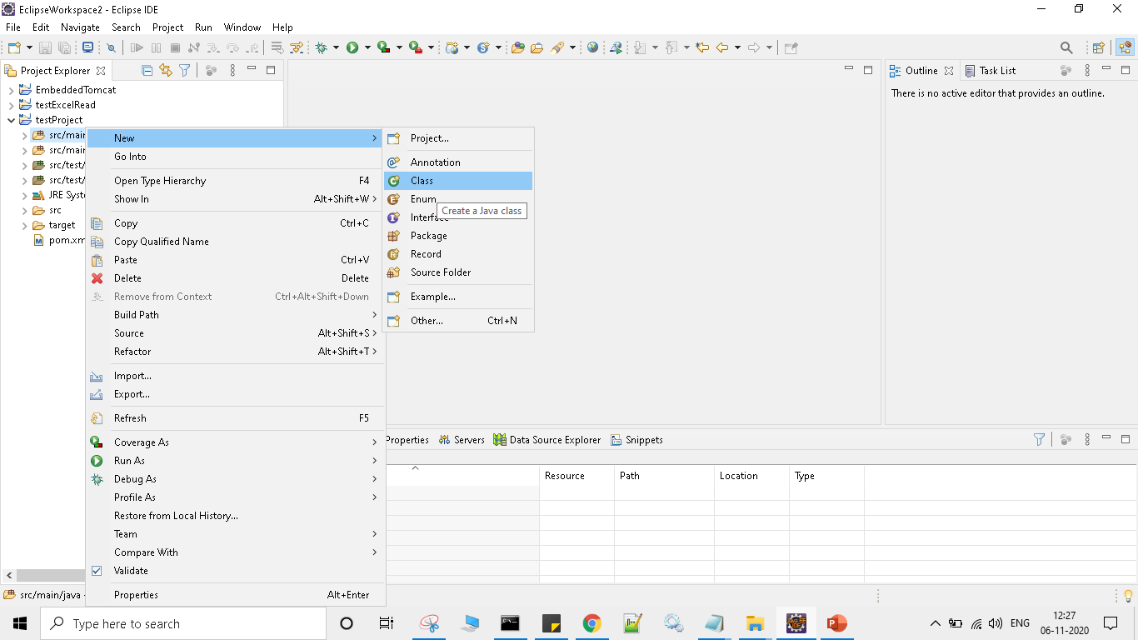

Slide 9
Place the source code and run as Java Application

